Slide 1
IBM University Engagement Project Submission
“Exploring the Power of Agentic AI with IBM Granite and IBM Bob”

Slide 2
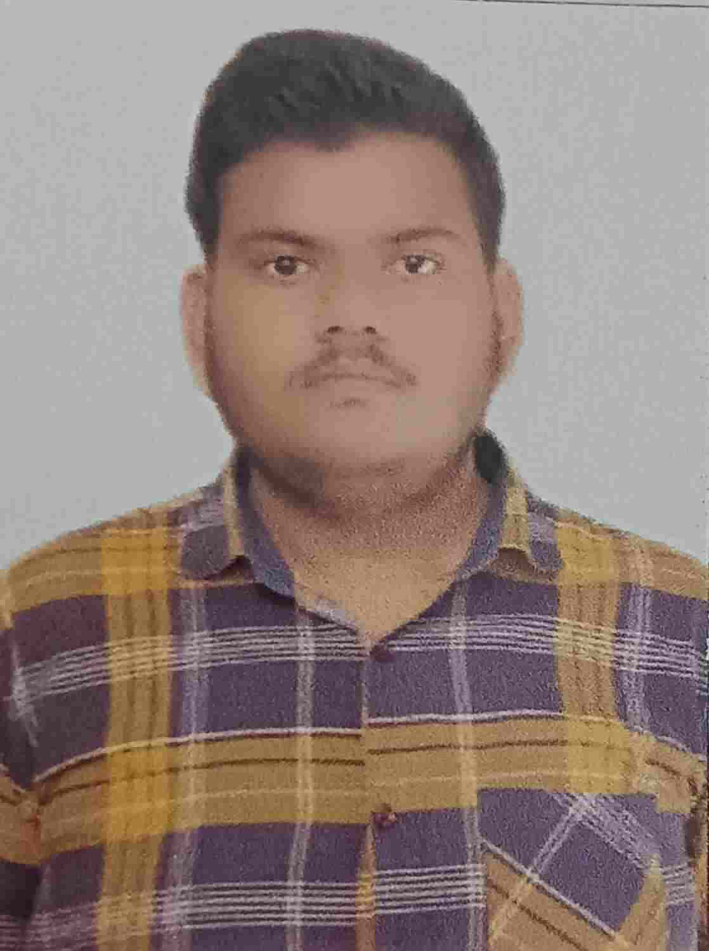
Project Tile – [Write your project title here]
Domain of Project – [ like Agriculture / Education / Healthcare / … ]
Student Name | Recent Passport Photo | Email ID | Mobile number [WhatsApp]
UPENDER |  | upenderrajput2903@gmail.com | 8375948836
Recommended font style and size:
Font Style: Arial
Font Size (Heading): 28
Font Size (Content): 20

Slide 3
Problem Statement -
Problem Statement : Street Vendor Digitalization Agent
The Challenge
Local hawkers and micro-entrepreneurs often struggle to build a strong digital presence, attract online customers, manage digital payments, and access reliable information about government schemes and business opportunities. Information about digital onboarding, UPI payments, local SEO, MSME schemes, and customer engagement is scattered across different platforms and sources.
Without simple, accessible, and practical digital guidance, many informal businesses remain invisible in the online economy and may miss opportunities to increase visibility, reach new customers, and access formal financial services.
The Objective
Build a RAG-powered Street Vendor Digitalization Agent that provides practical digital-business guidance for local hawkers and micro-entrepreneurs. The solution should:
Business Profile Generation – Create a practical digital business profile based on the vendor's business type, products/services, and location.
Digital Payment Guidance – Provide step-by-step guidance for UPI, QR-code setup, and digital payment onboarding.
Local SEO & Online Visibility – Suggest strategies to improve local search visibility and help vendors understand suitable online listing platforms.
Government & MSME Information RAG Retrieval – Retrieve and summarize relevant information about government policies, MSME schemes, and digital-business support from reliable sources.
Customer Engagement & Marketing – Provide practical promotional ideas, customer engagement tips, and marketing suggestions suitable for local businesses.
Hyperlocal Business Support – Use the vendor's business type and location to provide relevant suggestions for reaching nearby customers and improving local visibility.
Multilingual Assistance – Provide guidance in Hindi, Hinglish, or English, making digital tools easier to understand for vendors with different levels of digital literacy.
RAG-Based Knowledge Retrieval – Retrieve relevant information from a curated knowledge base before generating responses, helping reduce unsupported or fabricated information.
Responsible AI Guidance – Avoid inventing government schemes, eligibility criteria, prices, guarantees, or other factual information and encourage verification through official sources when required.
Digital Growth Support – Help informal businesses strengthen their online presence, improve customer reach, and participate more effectively in the hyperlocal digital economy.

Slide 4
Proposed Solution -
Proposed Solution: AI-Powered Street Vendor Digitalization Agent
The proposed solution is a RAG-powered AI agent built using IBM Bob, IBM watsonx.ai, and IBM Granite to help street vendors and micro-entrepreneurs grow digitally.
The system uses RAG to retrieve relevant information from a curated knowledge base covering digital payments, local SEO, government/MSME schemes, marketing, pricing, and business growth.
The solution provides key capabilities:
Business Profile Generation – Create digital business profiles based on business type and location.
UPI & Digital Payments – Provide simple guidance for UPI and QR-code setup.
Local SEO & Online Visibility – Help vendors improve local search presence and reach nearby customers.
Government & MSME Information – Provide relevant scheme and business-support information.
Marketing & Customer Engagement – Suggest practical promotional and customer-retention strategies.
Multilingual Support – Provide guidance in Hindi, Hinglish, and English.
RAG-Based Responses – Retrieve relevant knowledge before generating answers to improve reliability.
The solution includes a user-friendly Streamlit dashboard for vendor onboarding, AI chat, business profile, UPI, SEO, marketing, and growth guidance.

Slide 5
Technology Used
• IBM Bob platform – For designing, developing, and refining the AI agent workflow.
• IBM Granite Model – ibm/granite-3-8b-instruct – For natural language understanding, reasoning, and response generation.
• IBM Cloud – Provides the infrastructure to build, deploy, and run the VendorSetu AI solution.
• RAG – Retrieves relevant business information first, then generates grounded and reliable answers.
• IBM watsonx.ai – For Granite model integration and AI development.
• TF-IDF + Cosine Similarity – For efficient RAG-based retrieval from the vendor knowledge base.
• Python & Streamlit – For application development and the user-friendly dashboard.

Slide 6
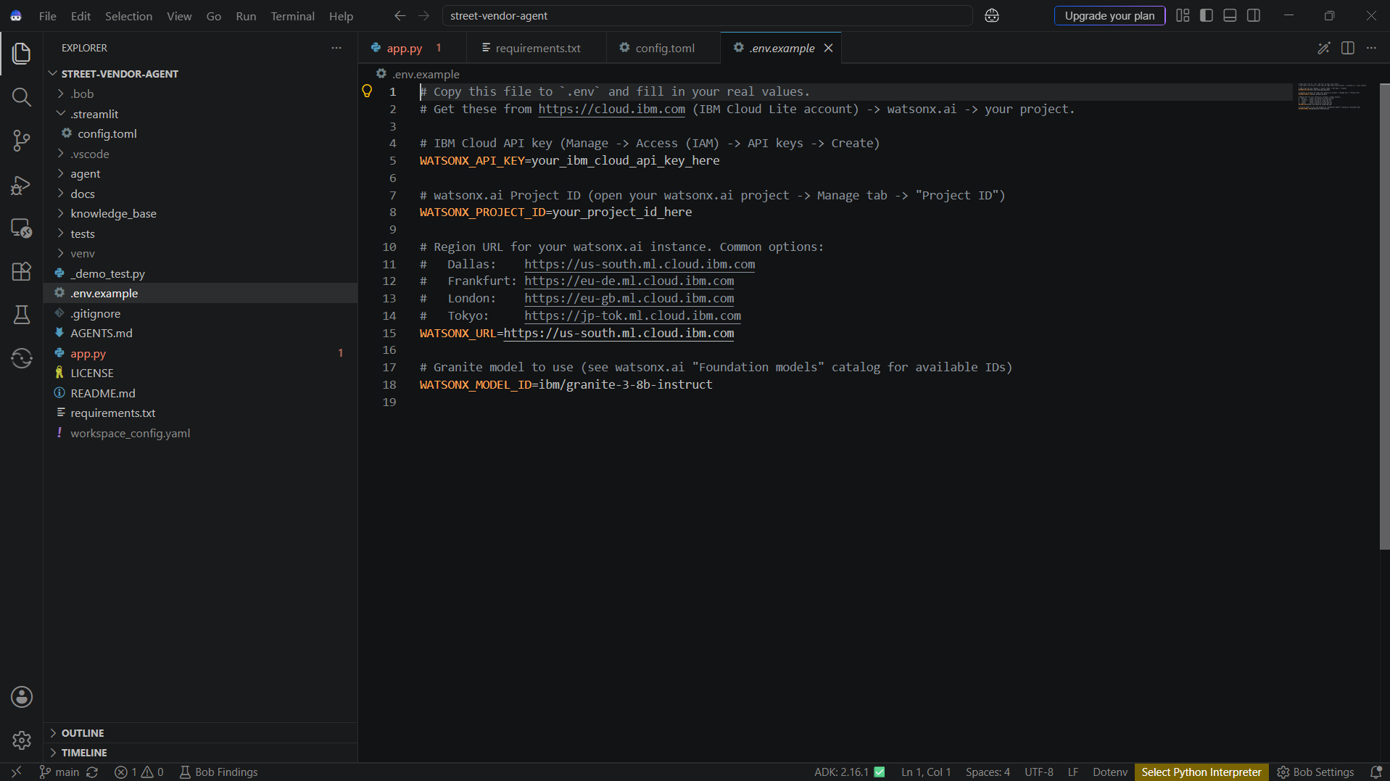
Required Files created using IBM bob -

Slide 7
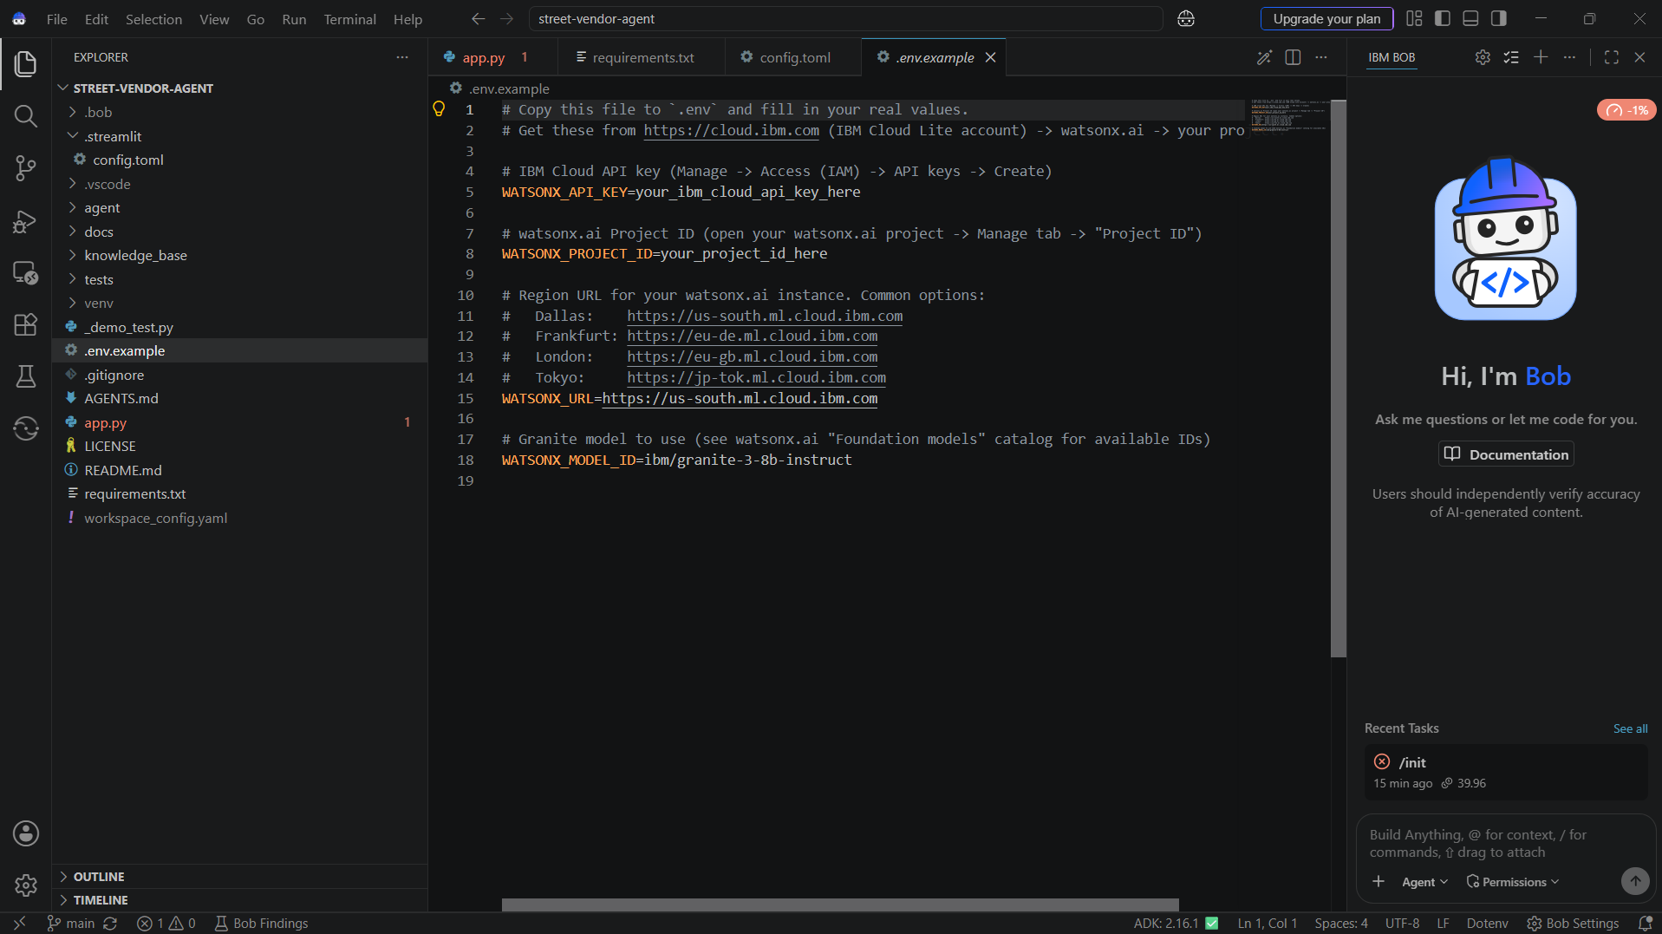
IBM Bob Screenshots:

Slide 8
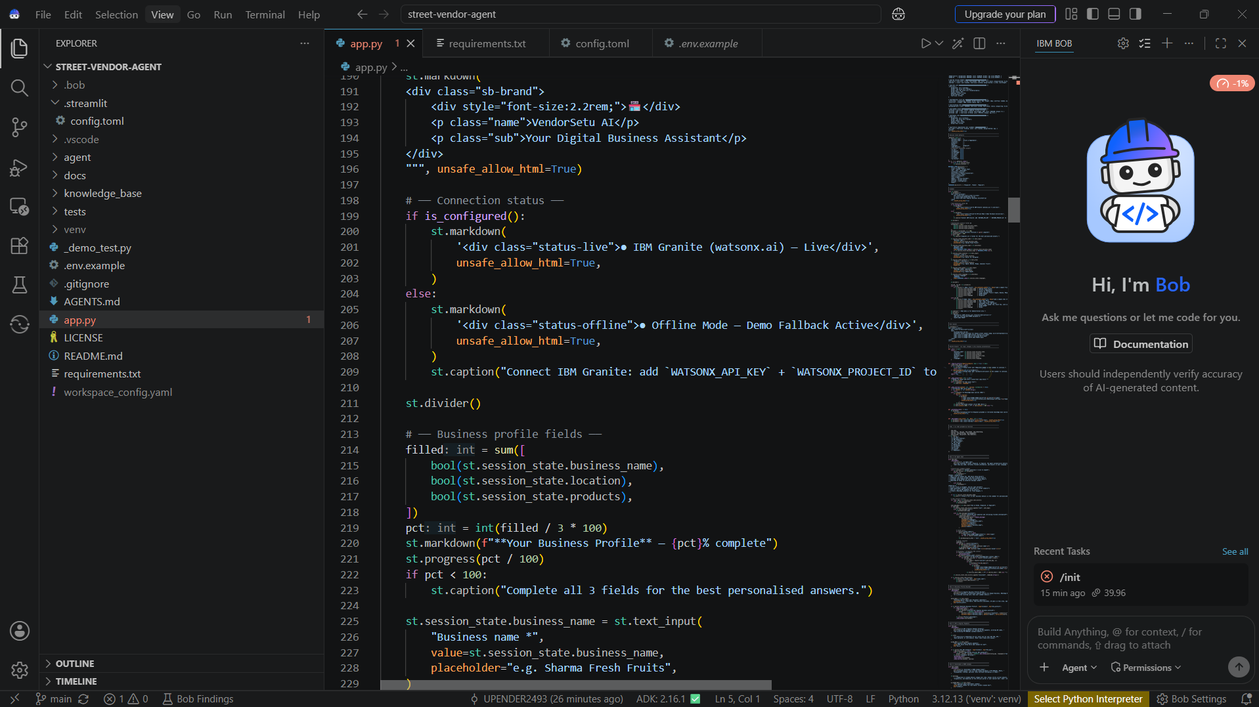

Slide 9
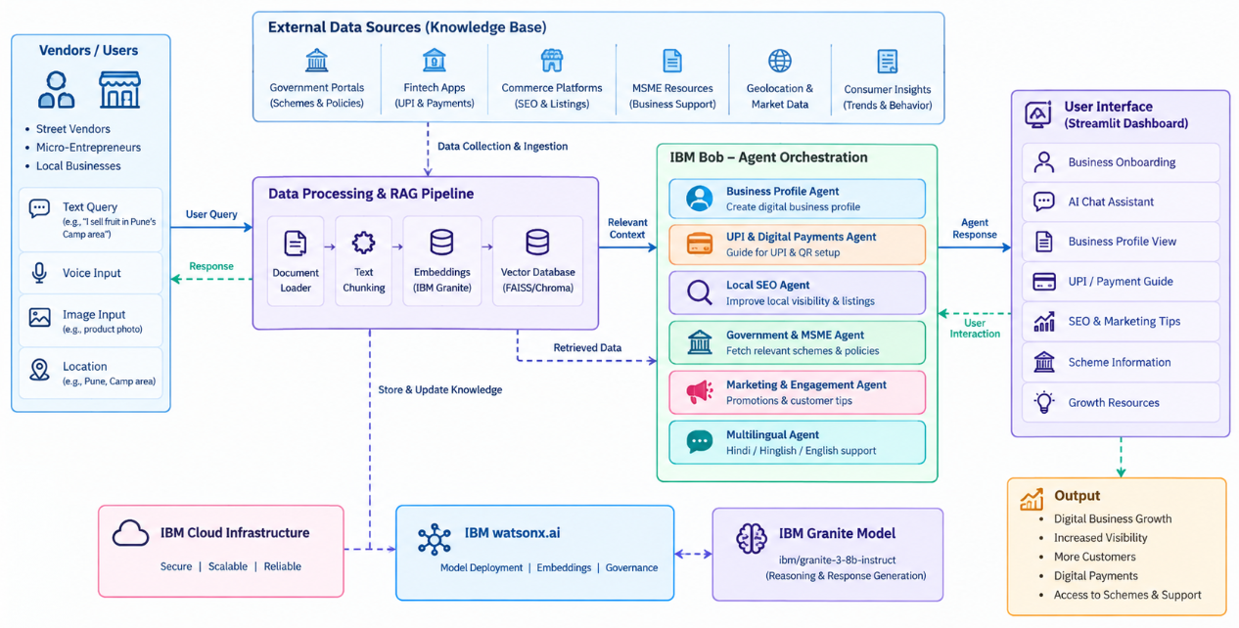
Architecture blueprint for IBM bob:

Slide 10

Role of Agentic AI in the solution
Role of Agentic AI in VendorSetu AI
Agentic AI enables VendorSetu AI to function as an intelligent, task-oriented system rather than a simple chatbot. Using IBM watsonx.ai and IBM Granite, it coordinates different business-support workflows to provide practical digitalization guidance.
Each workflow performs a specific role—such as creating business profiles, providing UPI guidance, improving local SEO, accessing government/MSME information, and suggesting marketing strategies.
Agentic AI also provides context awareness, using details such as the vendor's business type, services/products, and location to generate relevant recommendations.
The system uses RAG to retrieve relevant information before generating responses, helping provide more grounded and reliable guidance.
Overall, Agentic AI makes VendorSetu AI practical, personalized, and goal-driven, helping local businesses improve their digital visibility, customer reach, and business growth.

Slide 11
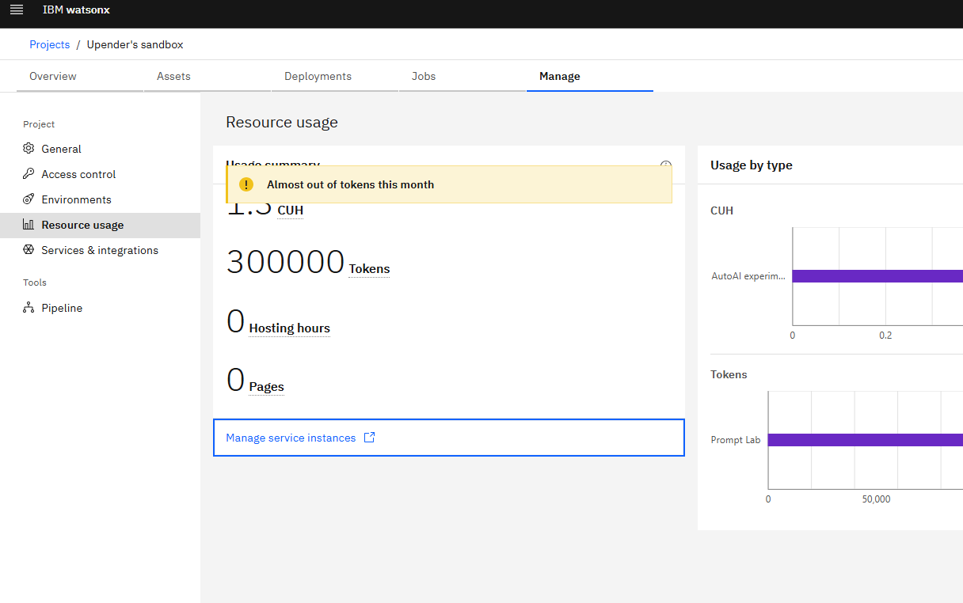
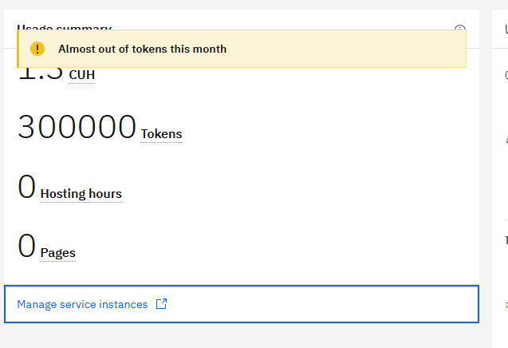
Token Usage
11,761 token are used
Before Prompt
After the Prompt
·
·
·

Slide 12
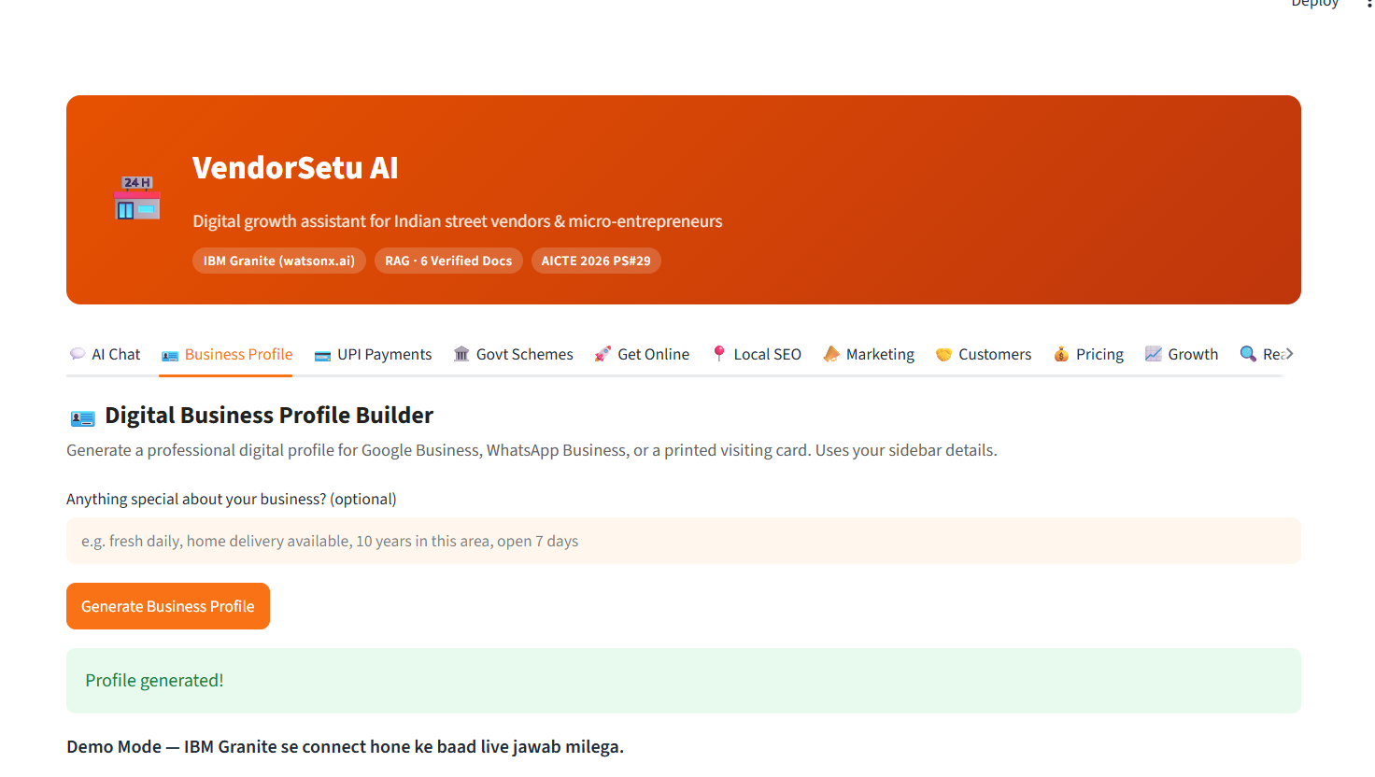
Project Output Screenshot
·
·
·

Slide 13
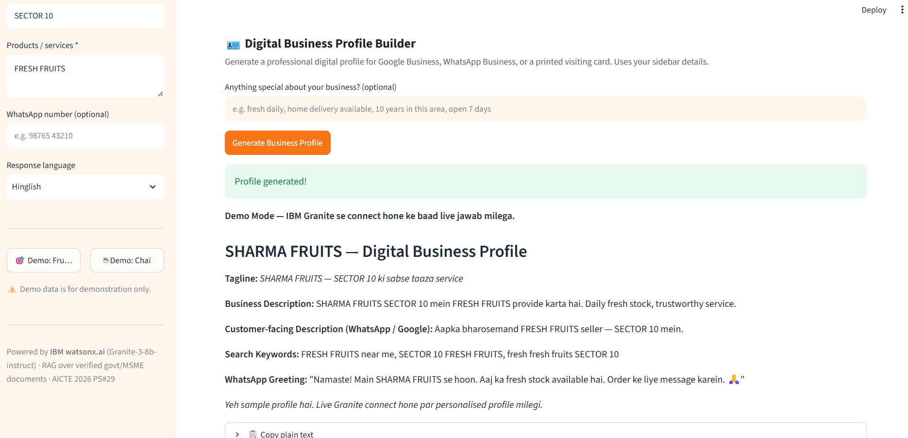
Project Output Screenshot
·
·
·

Slide 14
Project Output Screenshot
·
·
·

Slide 15
Novelty and Uniqueness
The proposed VendorSetu AI stands out by combining Agentic AI, RAG, and business personalization into a single digitalization assistant.
Task-Oriented Intelligence – Handles different business needs such as profiles, UPI, SEO, marketing, and growth.
RAG-Based Accuracy – Retrieves relevant knowledge before generating responses, reducing unsupported information.
Hyperlocal Personalization – Uses the vendor's business type and location to provide relevant digital-growth suggestions.
Digital Payment Support – Provides practical guidance for UPI and QR-code onboarding.
Local Business Visibility – Helps vendors improve local SEO and online customer reach.
Multilingual Support – Provides simple guidance in Hindi, Hinglish, and English.
Responsible AI – Avoids fabricating government schemes, eligibility, prices, or guarantees.
This makes VendorSetu AI a practical and accessible digital business assistant for local vendors and micro-entrepreneurs, rather than just a general chatbot.

Slide 16
Git Hub Link
Github URL – https://github.com/UPENDER2493/street-vendor-agent
·
·
·

Slide 17
Future Scope
Integration with Digital Marketplaces & Online Platforms –
The system can be integrated with online marketplaces and local business platforms to help vendors create and manage digital listings. This will improve their online visibility and enable them to reach more customers in the hyperlocal market.
2. AI-Powered Voice Assistant & Multilingual Support –
Enhancing the system with voice-based interaction and support for multiple Indian languages will improve accessibility. Vendors can interact naturally in their preferred language, making digital guidance easier for users with limited digital literacy.
·
·
·

Slide 18
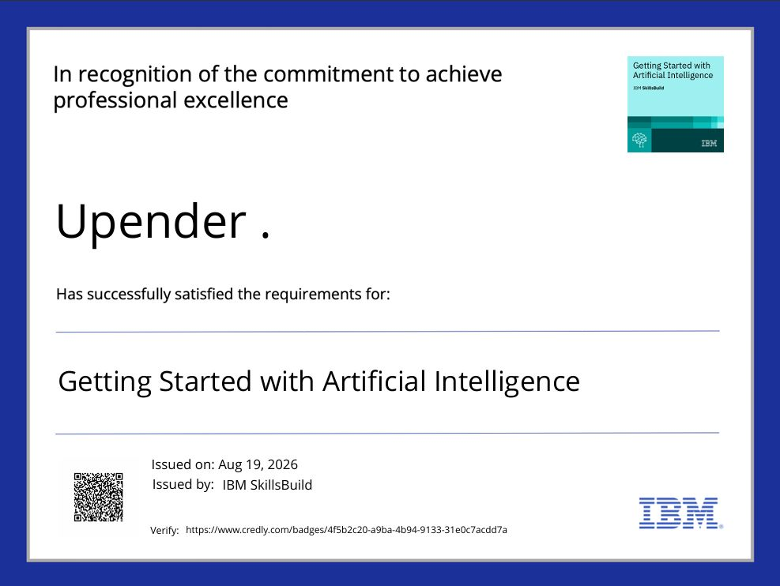
Certificates Earned:

Slide 19
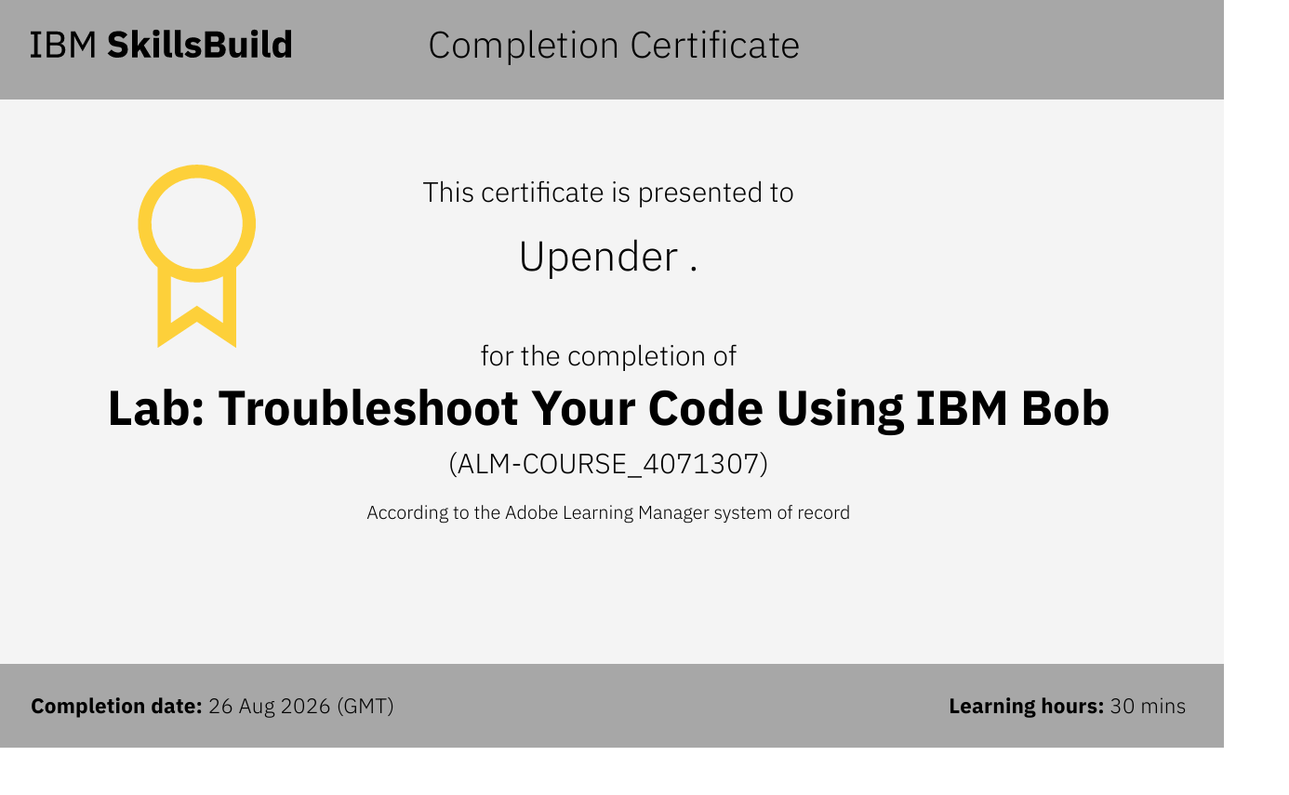
Certificates Earned:​

Slide 20


